Slide 1
Galih Anggoro Prasetya 22205018 Teknik Informatika

Slide 2
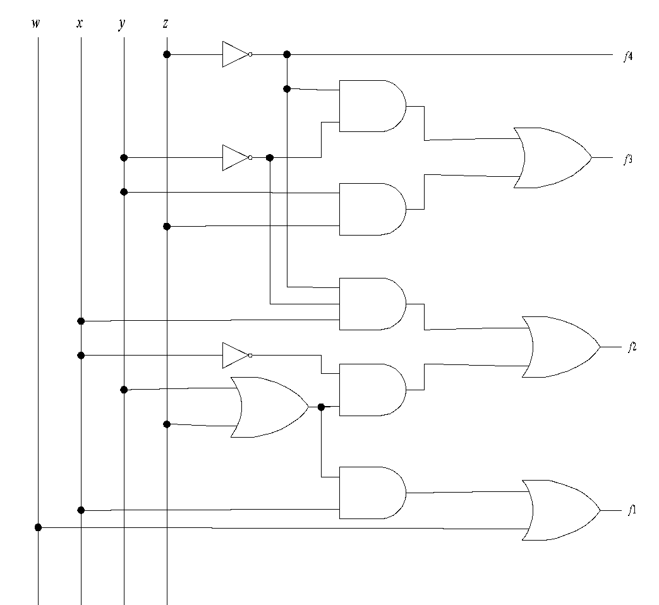
z’
y’z
y’z + yz
yz
xy’z’
x’
xy’z’ + x’y + x’z
x’y + x’z
y + z
xy + xz
x
w + xy + xz
w

Slide 3
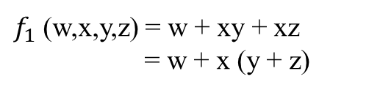

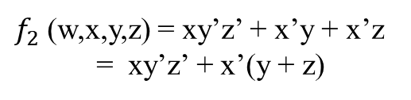

a. $f_{1}$ (w,x,y,z)
b. $f_{2}$ (w,x,y,z)
yz
yz
00
01
11
10
00
01
11
10
wx
0 | 0 | 0 | 0
0 | 1 | 1 | 1
0 | 0 | 0 | 0
1 | 1 | 0 | 0
x
0 | 0 | 1 | 1
1 | 0 | 0 | 0
1 | 0 | 0 | 0
0 | 1 | 1 | 0
00
0
01
1
11
1
10
0
$f_{1}$ (w,x,y,z) = w + xy + xz
= w + x (y + z)
$f_{2}$ (w,x,y,z) = xy’z’ + x’y + x’z
= xy’z’ + x’(y + z)

Slide 4




c. $f_{3}$ (w,x,y,z)
$d. f_{4}$ (w,x,y,z)
yz
yz
00
01
11
10
wx
00
01
11
10
wx
00
0 | 0 | 0 | 0
1 | 0 | 1 | 0
1 | 0 | 1 | 0
1 | 0 | 1 | 0
00
0 | 0 | 0 | 1
1 | 0 | 0 | 1
1 | 0 | 0 | 1
0 | 0 | 0 | 0
01
01
11
11
10
10
$f_{3}$ (w,x,y,z) = y’z
$f_{4}$ (w,x,y,z) = z’

Slide 5
Selesai

